Slide 1
Facial Expression Recognition using Convolutional Neural Networks
Author: Erik Greblo
Mentor: assoc. prof. Marina Bagić Babac
SEMINAR II

Slide 2
Topics
Machine learning
Deep learning
Facial expression recognition
Neural networks
Convolutional neural networks
Model comparison

Slide 3
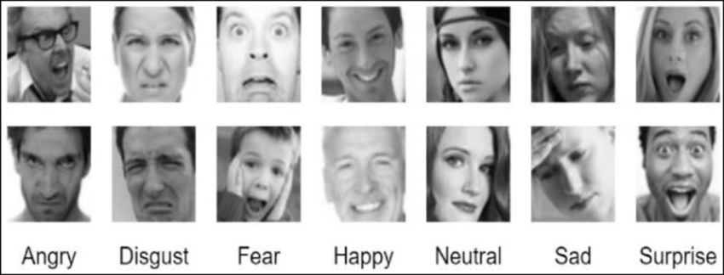
Task
Recognizing different facial expressions
7 expressions
36000 images
48x48 pixels
Unbalanced dataset

Slide 4
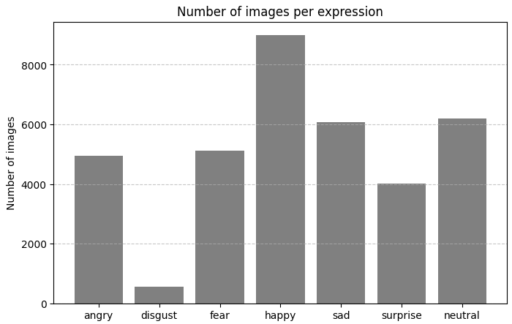

Slide 5
Model layers

Slide 6
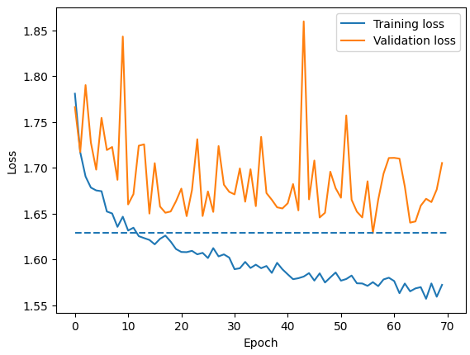
Fully connected model
One fully conected layer
48x48 -> 7
Accuracy = 35%
Doesn’t learn the relationship of a pixel with its neighbours

Slide 7
Convolutional model
Contains at least one convolutional layer
Convolutional layer consists of filter which acts as a mask over the image, sliding across every pixel and multiplying its weights with a small area of the input, over which the filter is currently placed.

Slide 8
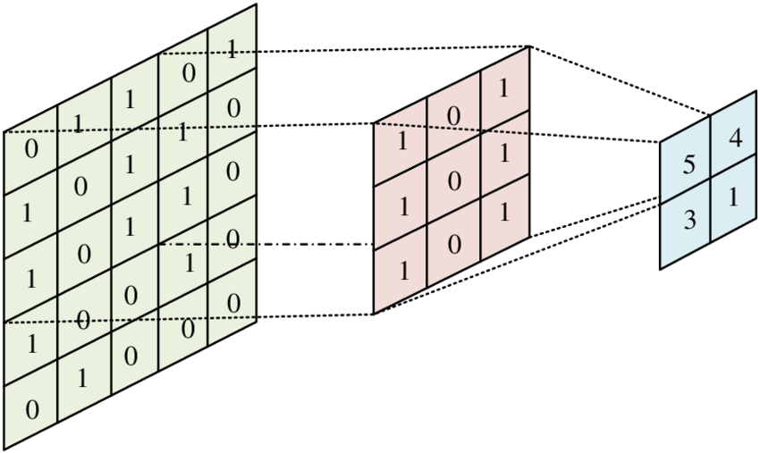

Slide 9
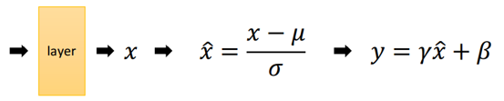
Batch normalization
parameters: α and β
Layer normalization
Stabile learning
Reduces overfitting

Slide 10
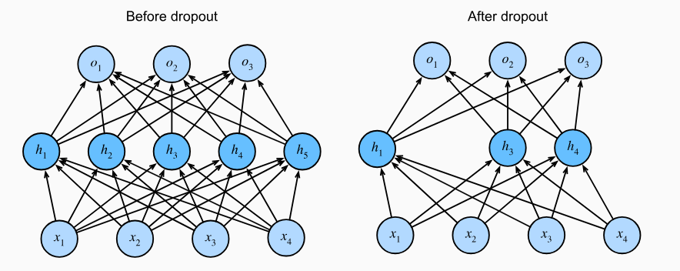
Dropout
Regularization technique – randomly deactivates a subset of neurons during training
Prevents overfitting
Active only during training

Slide 11
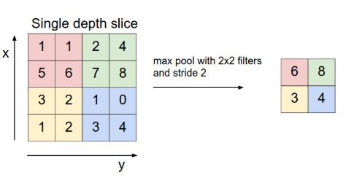
Max pooling
Reduces the dimensionality of the output
Increases performance
Noise reduction
Translation invariance
Notes:
s

Slide 12
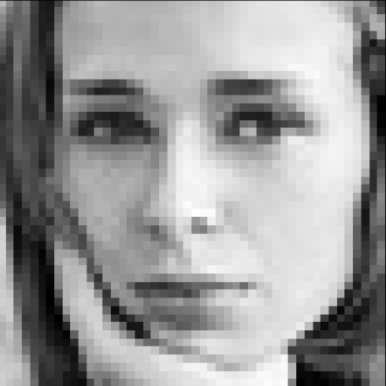
Model design
CONV
BN
RELU
DROPOUT
MAX
POOL
input
M
% ANGRY
% DISGUST
% FEAR
% HAPPY
% NEUTRAL
% SAD
% SURPRISE
FC
BN
RELU
DROPOUT
FC
SOFTMAX
output
N

Slide 13
Tested models
SHALLOW MODEL
DEEP MODEL
DEEPER MODEL
M = 2 (32 3x3 – 64 5x5)
N = 1 (512)
Learning rate = 1e-5
Weight decay = 1e-7
M = 4 (64 3x3 – 128 5x5 – 512 3x3 – 512 3x3)
N = 2 (256 - 512)
Learning rate = 1e-4
Weight decay = 1e-7
M = 5 (64 3x3 – 128 5x5 – 256 3x3 - 512 3x3 – 512 3x3)
N = 2 (256 - 512)
Learning rate = 1e-4
Weight decay = 1e-7
Accuracy = 53%
Accuracy = 59%
Accuracy = 62%

Slide 14
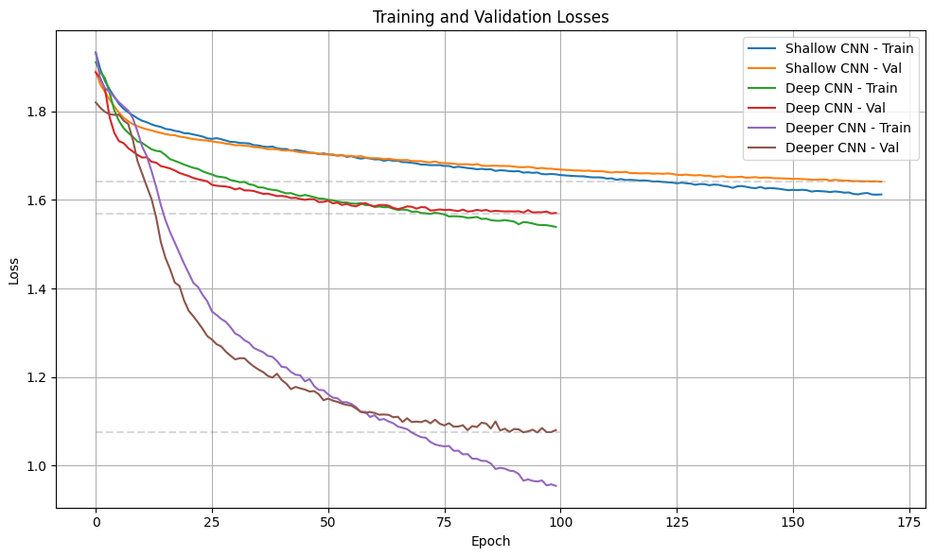

Slide 15
ACCURACY FOR EACH EXPRESSION
Expression | Shallow Model | Deep Model | Deeper Model
Angry | 32.0% | 45.9% | 49.7%
Disgust | 0.0% | 0.0% | 39.2%
Fear | 19.4% | 24.2% | 23.8%
Happy | 79.9% | 84.2% | 86.8%
Sad | 46.4% | 49.6% | 51.0%
Surprise | 64.4% | 73.3% | 81.4%
Neutral | 62.2% | 65.8% | 65.1%

Slide 16
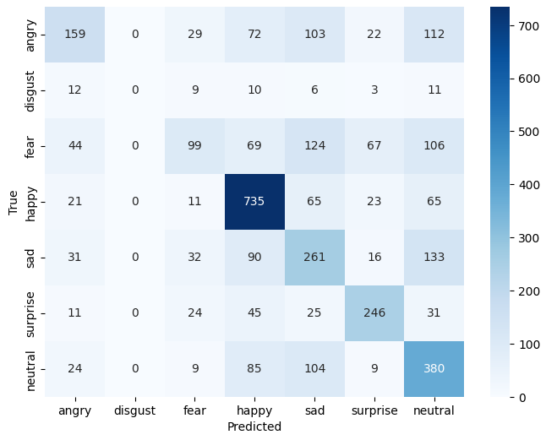
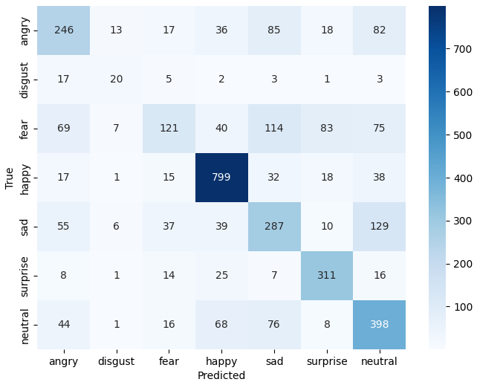
deep model
deeper model

Slide 17
CONCLUSION
Convolutional networks are a powerful tool in computer vision, solving problems that simple neural network models couldn’t solve because of their simplistic design.
Their ability to learn increasingly abstract representations through stacked layers makes them highly effective for complex visual understanding, which is needed in the detection of facial expressions.

Slide 18
References
Shima Alizadeh, Azar Fazel (April 2017). Convolutional Neural Networks for Facial Expression Recognition. Available: https://arxiv.org/abs/1704.06756
Face expression recognition dataset (2019). Available: https://www.kaggle.com/datasets/jonathanoheix/face-expression-recognition-dataset
https://cs231n.github.io/convolutional-networks/
https://medium.com/hitchhikers-guide-to-deep-learning/9-introduction-to-deep-learning-with-compute-vision-normalization-batch-normalization-ba5f60c77cf3
https://www.researchgate.net/figure/Convolution-operation-diagram_fig1_374552194
https://pytorch.org/
https://www.researchgate.net/publication/362742399_Convolutional_Neural_Network_CNN_A_comprehensive_overview

Slide 19
Thank you for listening!

